Slide 1
Predict your weight by your parental weight
Kevin yang

Slide 2
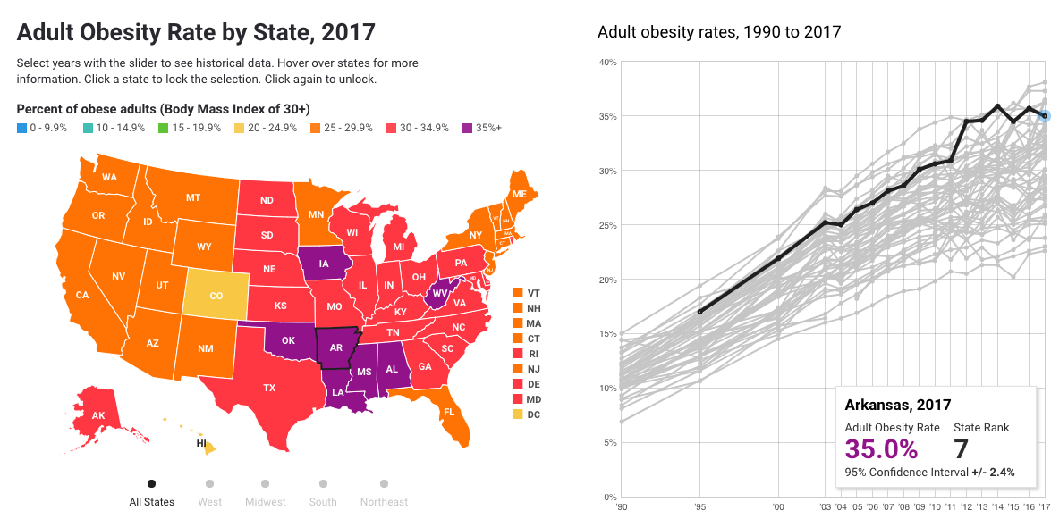
Adult obesity in the united states
Notes:
This graph is from state of obesity.org
You could see that the obesity rate has increased gradually. The data from 1990-2017
Especially for the obesity in children

Slide 3
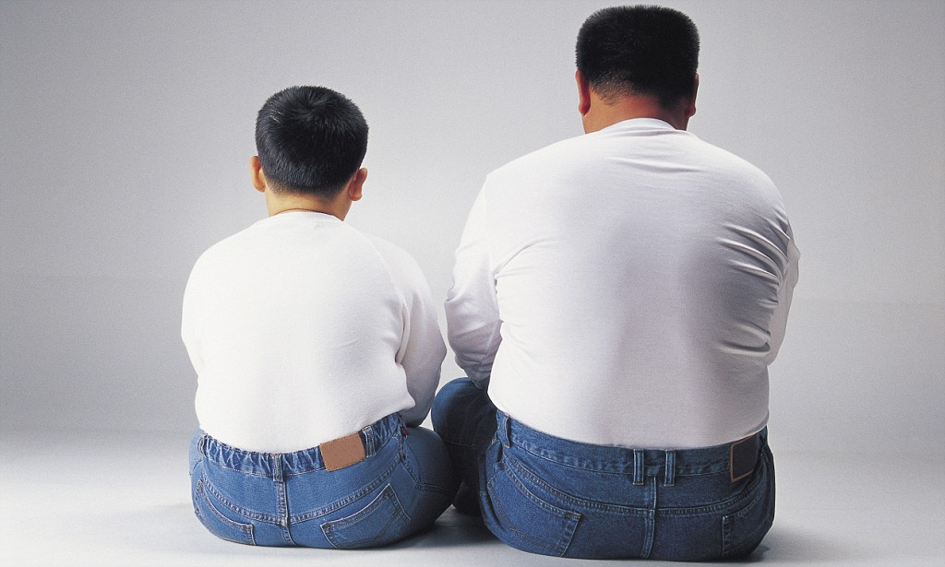
Research founding
Studies suggest that while your genes may determine up to 80 percent of your weight and body shape.
–2/8/2010
Notes:
There was a study in 1990’s done on identical twins indicated that genes pretty much determined adult shape and size. But new research is uncovering a more nuanced view. Some aspects of shape and size, it turns out are more closely tied to genes than others.
The ease with which you develop muscle mass is a highly inherited trait. A study found that while you need physical activity in order to build muscle, people who have “muscular” genes require far less exercise than others to look fit.

Slide 4
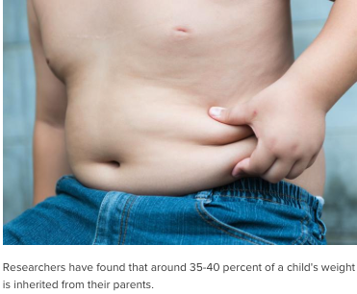
Research founding
From an analysis of around 100,000 children from six countries—including the United States—researchers found that around 20 percent of a child’s body mass index (BMI) is inherited from their mother, while a further 20 percent is inherited from their father.
–2/21/2017

Slide 5
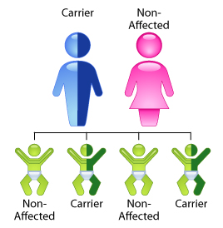
introduction
“You inherit half of your genes from your mother and half from your father, so you are a blend. You can be unlucky and get the worst possible combination from both parents, or be lucky and get the best.” says Harvard medical professor C. Ronald Kahn, M.D.
Notes:
“You inherit half of your genes from your mother and half from your father, so you are a blend. You can be unlucky and get the worst possible combination from both parents, or be lucky and get the best.” says Harvard medical professor C. Ronald Kahn, M.D.

Slide 6
objective
Can we predict the weight directly by parental weight?
Different race may contain different genes to influence children’s weight?

Slide 7
dataset
“Desired Dataset” –time series data
Father and Mother’s Height and Weight
Their offspring’s Height and Weight
Different races
Notes:
However, it is hard to find those data in the open dataset,
Dr causey gave me a reference for the dataset though, but after I read the research paper and took a look about dataset
To be honestly, I have no idea what are they doing…

Slide 8
approach
Two dataset, try to simulate their relationship
Children | Mean | STD
Sex | 0.370 | 0.485
Age | 24.250 | 6.125
Height | 72.129 | 27.868
Weight | 139.130 | 25.281
Race | 1.630 | 0.661
Parent | Mean | Standard Deviation
Age | 23.238 | 5.298
Mother’s weight | 129.814 | 30.579
Baby’s weight | 2944.587 | 729.214
Race | 1.846 | 0.918
Notes:
The age between both child and parent are around 15-40
The height in the child table may have a problem, because it contain huge difference.. I assume that is random

Slide 9
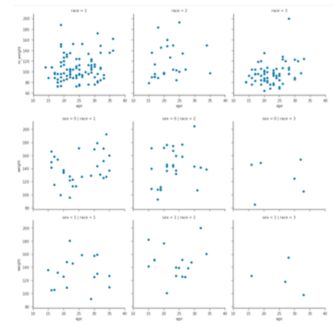
Distribution
Notes:
Race 1 = white race 2 = black race 3 = other
Sex 0 = girl
Sex 1 = boy

Slide 10
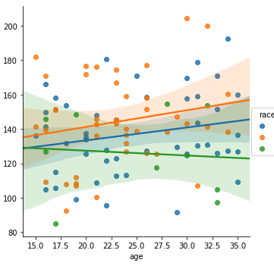
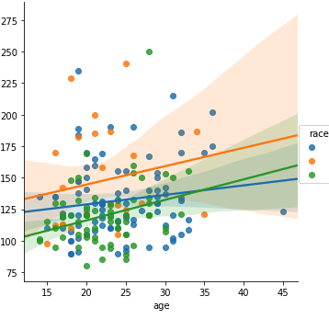
trend
children
parent

Slide 11
prediction
 | Cross Validation Accuracy |  | F1-Score | AUC
Cild | Linear Regression | -0.10 (+/- 0.05)
 | Support Vector Machine | 0.03 (+/- 0.02)
 | Random Forest |  | 0.290 | 0.780
Parent | Linear Regression | -17.33 (+/- 6.50)
 | Support Vector Machine | 0.37 (+/- 0.17)
 | Random Forest |  | 0.344 | 0.780

Slide 12
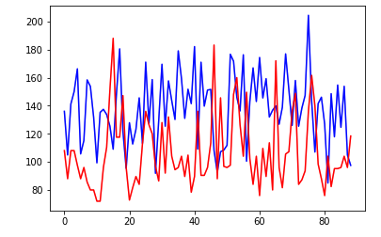
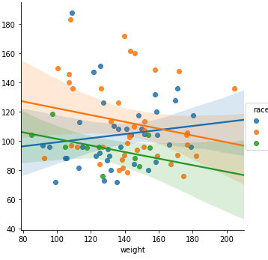
comparison
overall
trend
Notes:
After I adjust parental weight by 80%

Slide 13
prediction
 | Cross Validation Accuracy |  | F1-Score | AUC
Parent-Child | Linear Regression | -0.49 (+/-0.15)
 | Support Vector Machine | 0.20 (+/- 0.12)
 | Random Forest |  | 0.283 | 0.769

Slide 14
conclusion
Children’s weight are still higher than parental weight after I adjust their weight value by 80 percent.
Parental weight is related to child weight for sure according to family-based behavioral treatment programs and some other research
Some other factors influence offspring’s weight play more significant role
This dataset are not good enough to indicate the prediction for the parent-child weight

Slide 15
references
[1] State of Obesity.org, "Adult Obesity in the United State from 1990-
2017". (https://stateofobesity.org/adult-obesity/)
[2] Boutelle KN, Cafri G, Crow SJ. Parent predictors of child weight change in family based behavioral obesity treatment. Obesity (Silver Spring, Md) 2012;20(7):1539-1543. doi: 10.1038/oby.2012.48.
[3] Nature.com, "International Journal of
Obesity".( https://www.nature.com/ijo/).
[4] Women's health on NBCNEWS, "Destined to inherit your mom's
body?". (http://www.nbcnews.com/id/35254750/ns/health- womens_health/t/destined-inherit-your-moms-body/#.W_djT5NKhTZ).
[5] Helen Andrian, Chu-Yung Liao, Hsien-Wen Kuo. Parental weight changes as key predictors of child weight changes. (BMC Public Health.) 2015;15:645. doi:10.1186/s12889-015-2005-x.
[6] Reddit, r/datasets, "Students Weight, Sex, Height and race".
(https://www.reddit.com/r/datasets/comments/460fc5/students_weight_s exheight_and_race/).
[7] Vincentarelbundock.github, "Risk Factors Associated with Low Infant Birth Weight". (https://vincentarelbundock.github.io/Rdatasets/datasets.html).
[8] Brian H. Wrotniak, Ms; Leonard H. Epstein, Phd; Rocco A. Paluch, MS, "Parent Weight Change as a Predictor of Child Weight Change in Family-Based Behavioral Obesity Treatment". (https://jamanetwork.com/journals/jamapediatrics/fullarticle/485676).
[9] Yinghyu Lui, Hsin-Jen Chen, Lan Liang, Youfa Wang. "Parent-Child Resemblance in Weight Status and Its Correlates in the United States".
June 10.2013. doi:10.1371/journal.pone.0065361(https://journals.plos.org/plosone/arti cle?id=10.1371/journal.pone.0065361)
[10] Takehiro Sugiyama, Masako Horino, Kaori Inoue, Tasuki Kobayashi, Martin F. Shapiro, William J. McCarthy, " Trends of Child's Weight Perception by Children, Parents and Healthcare Professionals during the Time of Terminology Change in Childhood Obesity in the United States, 2005-2014". 2016 Dec 1; 12(6): 463-473. doi: 10.1089/chi/.2016.0128(https://www.ncbi.nlm.nih.gov/pmc/articles/PM C5107670/)

